Slide 1

Incident Impact Prediction
Mentor: Parth
Date: 24/02/2022
Group no. 6
Harshwardhan Prabodhan Pawar
SHIVA KHER
Jobin Joel J
Mr. Polisetti Sai
Mr. Pratik Sahebrao Ahire

Slide 2
Business Problem:
To predict the impact of the incident raised by the customer.
Objective:
The Objective of resolution is to predict the impact of the incident built by the customer and to develop the accuracy of model as well to figure out the important features combined with it.

Slide 3
Project Architecture / Project Flow :
Research about Incident Impact Prediction Exploratory
Data Analysis (EDA)
Data Cleaning
Feature Selection
Model Building
Model Testing
Deployment

Slide 4
Exploratory Data Analysis (EDA)
Treating Missing Values:
Missing values are represented as (?) thus Replacing With NAN
Roughly 40 percent of the secreted and syncretical data is missing.
Looking at column user symptom and assigned to less amount of data is missing nearly around 10% of data.
Looking at the problem id , rfc it looks like we are just missing too much of that data nearly 99% of data to do something useful with at a basic level. We'll probably drop it.

Slide 5
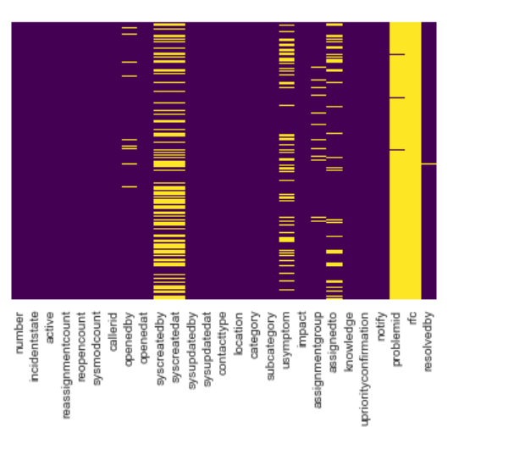
Data Visualization:
5 Columns have maximum number of Null values
We can use seaborn to create a simple heatmap to see where missing data. and here, we visualize the data impact wise such as High, Medium, Low We visualizes the missing data using heatmap and also visualizes active and unactive users impact wise.

Slide 6
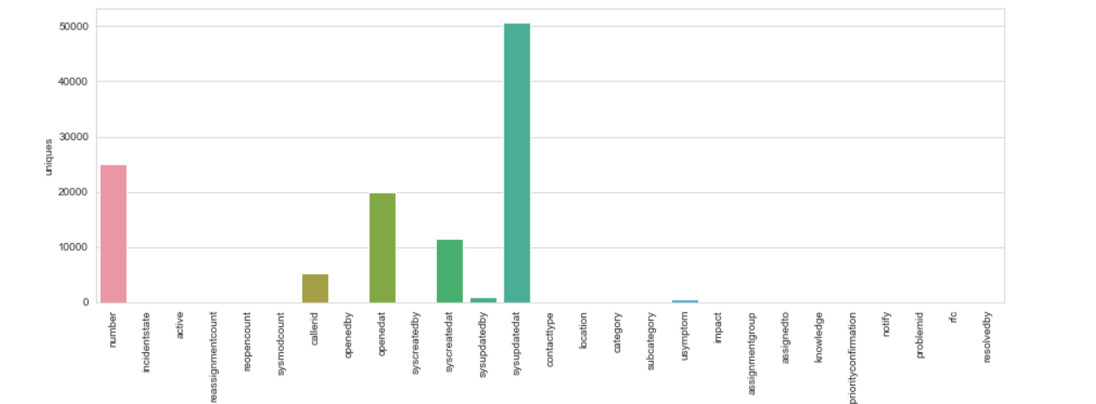

Slide 7
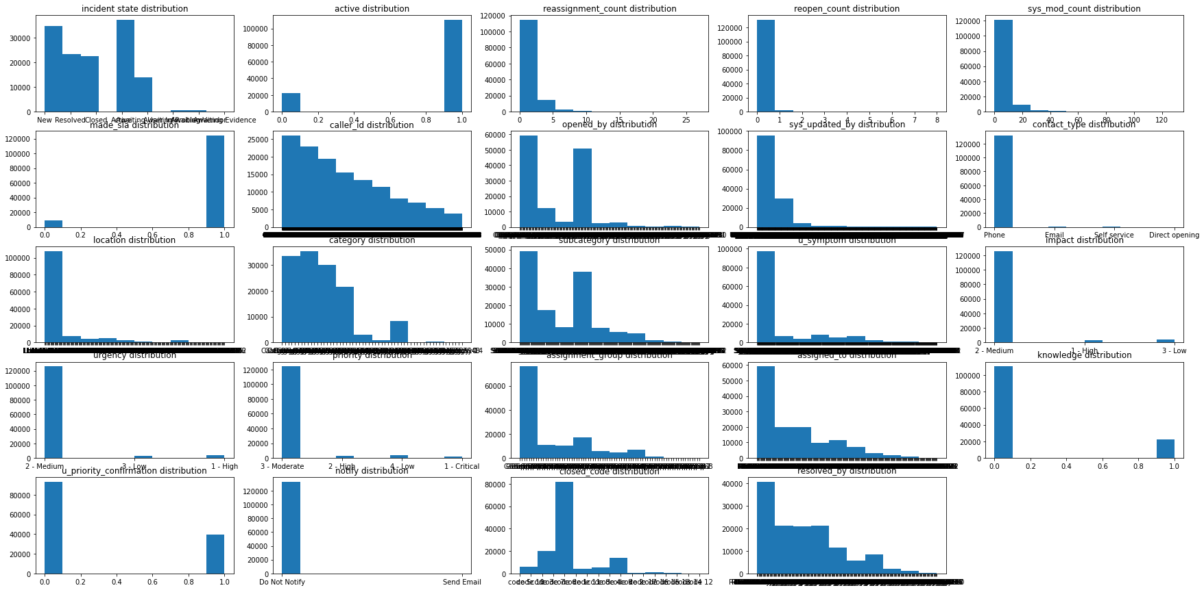
Data distribution Of features (Histogram)

Slide 8
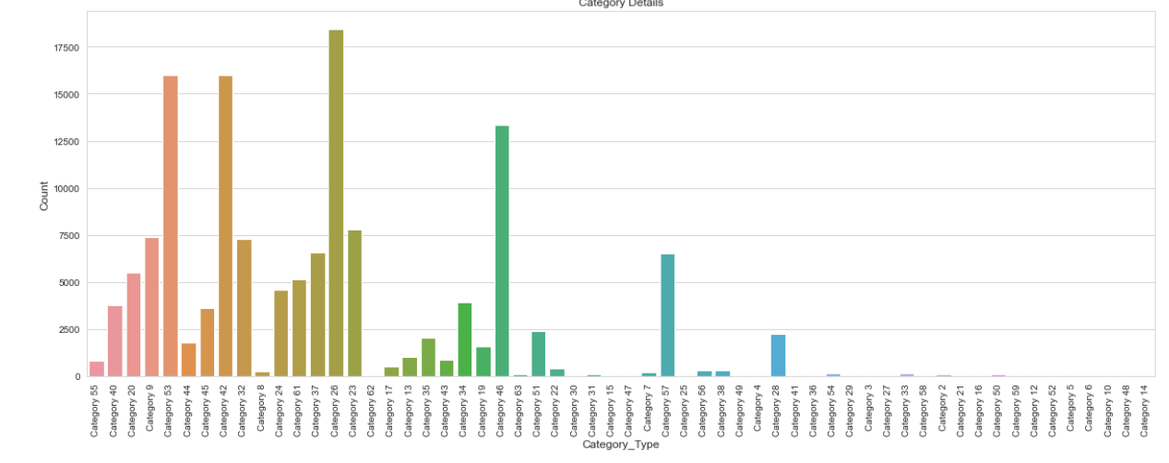

Slide 9
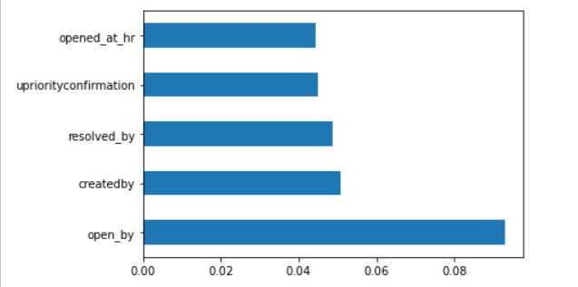
Feature Engineering
Feature Importance using Extra Trees Classifier
Algorithm Used: Extra Tree Classifier

Slide 10
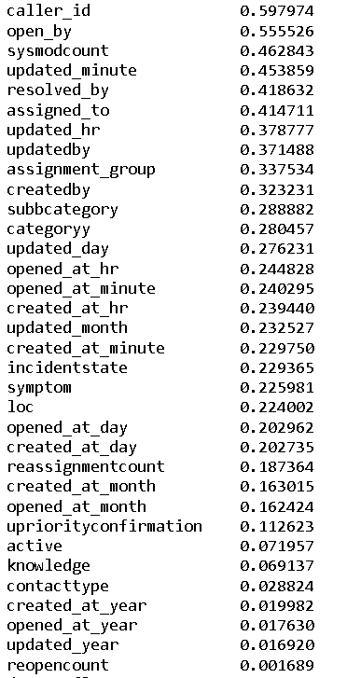
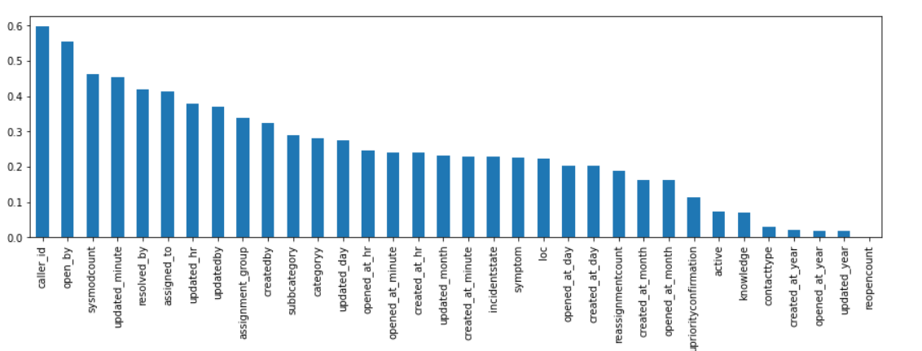
Feature Selection using Mutual information
Algorithm Used: mutual information classifier

Slide 11
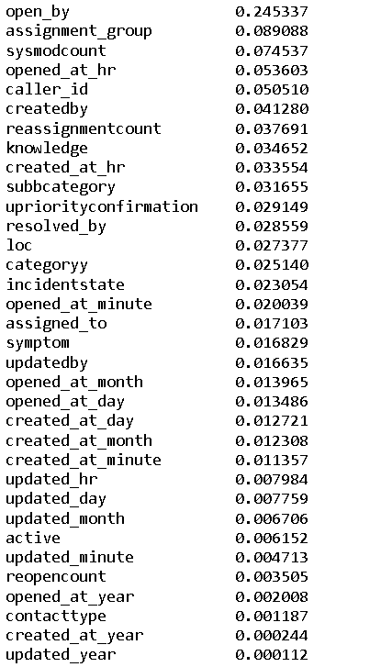
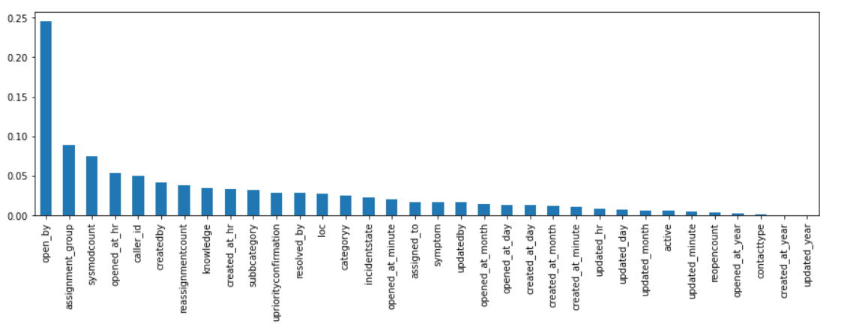
Feature Importance using Decision Tree Classifier
Algorithm Used: Decision Tree classifier

Slide 12
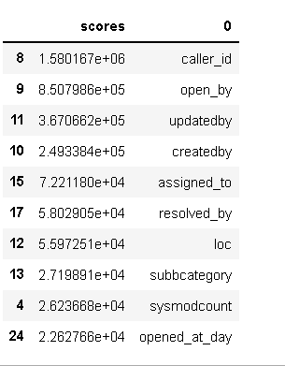
Feature Selection using Chi Square
Algorithm Used: Ordered rank Feature

Slide 13
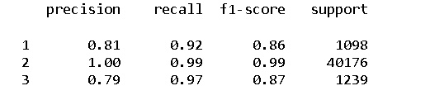
Model Building
1. Using Random Forest Algorithm
Accuracy Score : 98.42%

Slide 14
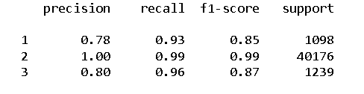
2. Using Decision Tree Algorithm
Accuracy Score : 98.37%

Slide 15
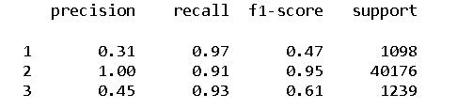
3. Using KNN Algorithm
Accuracy Score : 90.76%

Slide 16
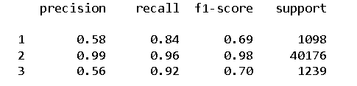
3. Using extreme Gradient Boosting
Accuracy Score : 95.73%

Slide 17
Model Results Summery
Model Used | Impact | Precision | Recall | F1 Score | Support | Accuracy
Decision Tree Algorithm | High | 0.78 | 0.93 | 0.85 | 1098 | 98.37%
 | Medium | 1 | 0.99 | 0.99 | 40176
 | Low | 0.80 | 0.96 | 0.87 | 1239
Random Forest Algorithm | High | 0.81 | 0.92 | 0.86 | 1098 | 98.42%
 | Medium | 1 | 0.99 | 0.99 | 40176
 | Low | 0.79 | 0.97 | 0.87 | 1239
KNN Algorithm | High | 0.31 | 0.97 | 0.47 | 1098 | 90.76%
 | Medium | 1 | 0.91 | 0.95 | 40176
 | Low | 0.45 | 0.93 | 0.61 | 1239
Extreme Gradient Boosting | High | 0.58 | 0.84 | 0.69 | 1098 | 95.73%
 | Medium | 0.99 | 0.96 | 0.98 | 40176
 | Low | 0.56 | 0.92 | 0.70 | 1239
Impact prediction using Decision Tree Algorithm data showed the highest accuracy, Precision, Recall and f1-score. Therefore, this model is Selected for deployment to predict the incident impact.

Slide 18
Model Deployment using R shiny / Flask or any other method

Slide 19
Challenges faced?
Data Preparation
Multiple Data Sources
Understanding The Business Problem
Unbalanced Data Set
How did you overcome?
By Doing research
Balanced the data by using SMOTE Technique
By doing Feature Engineering and Data Cleaning

Slide 20
Thank you

